Slide 1
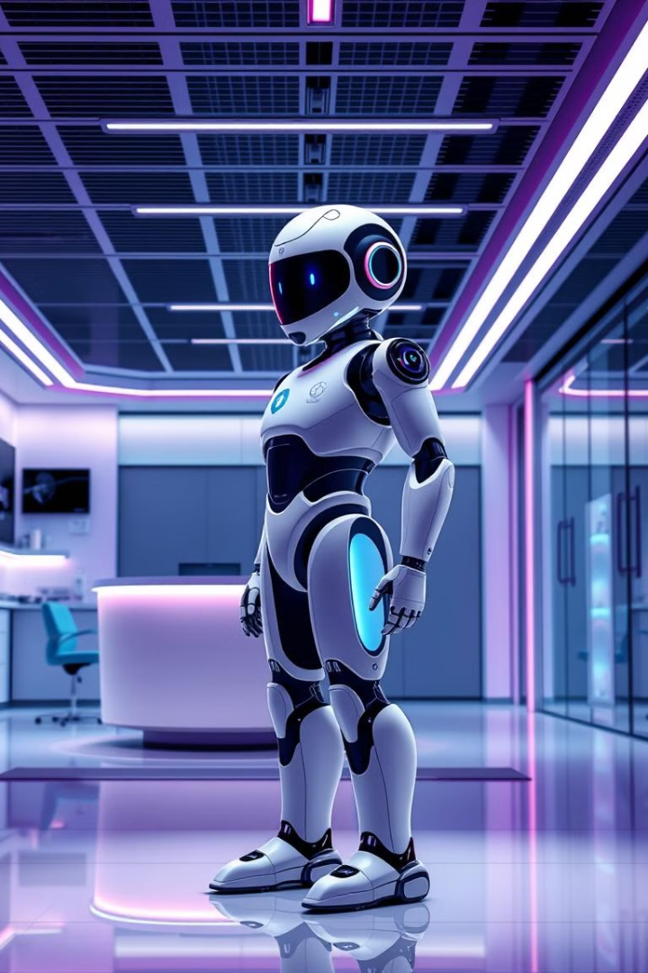
AI Healthcare Chatbot: Revolutionizing Patient Care Through Intelligent Automation
In a world grappling with increasing healthcare demands, AI-powered chatbots are emerging as a transformative force, revolutionizing patient care through intelligent automation.

Slide 2

The Growing Need for Healthcare Chatbots in Modern Medicine
Rising healthcare costs and limited resources
Growing demand for accessible and convenient care
Need for 24/7 support and faster response times

Slide 3
Core Components and Architecture Overview (Block Diagram)
User Interface
Natural Language Processing (NLP)
Machine Learning (ML)
Decision Support System
Interactive user interface for patient communication
Learns from past interactions and improves responses
Processes user queries and extracts key information
Provides clinical guidance and recommendations

Slide 4
Natural Language Processing and Machine Learning Integration
Natural Language Understanding (NLU)
Machine Learning (ML)
Dialogue Management
Continuously learns from user interactions and improves accuracy over time
Manages the conversation flow and guides interactions towards resolution
Enables the chatbot to comprehend user queries in natural language

Slide 5

Patient Data Flow and Security Infrastructure
1
Secure data collection from patients
2
Data encryption and secure storage in compliant databases
3
Real-time data analysis for personalized recommendations

Slide 6





Real-time Clinical Decision Support Features
Symptom Checker
Identifies potential health conditions based on user symptoms
Medication Reminder
Reminds patients to take their prescribed medications on time
Health Information
Provides reliable medical information on various health topics
Appointment Scheduling
Simplifies appointment scheduling and reduces wait times
Care Coordination
Ensures seamless communication between patients and healthcare providers

Slide 7
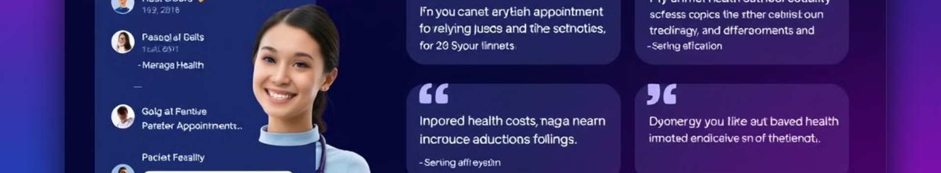
Implementation Case Study: Success Metrics and ROI
30%
15%
20%
Improved Patient Engagement
Reduced Costs
Increased Efficiency
Patients are more likely to actively participate in their healthcare
Lower healthcare expenses through automated workflows and reduced administrative burden
Streamlined processes and improved patient care delivery

Slide 8
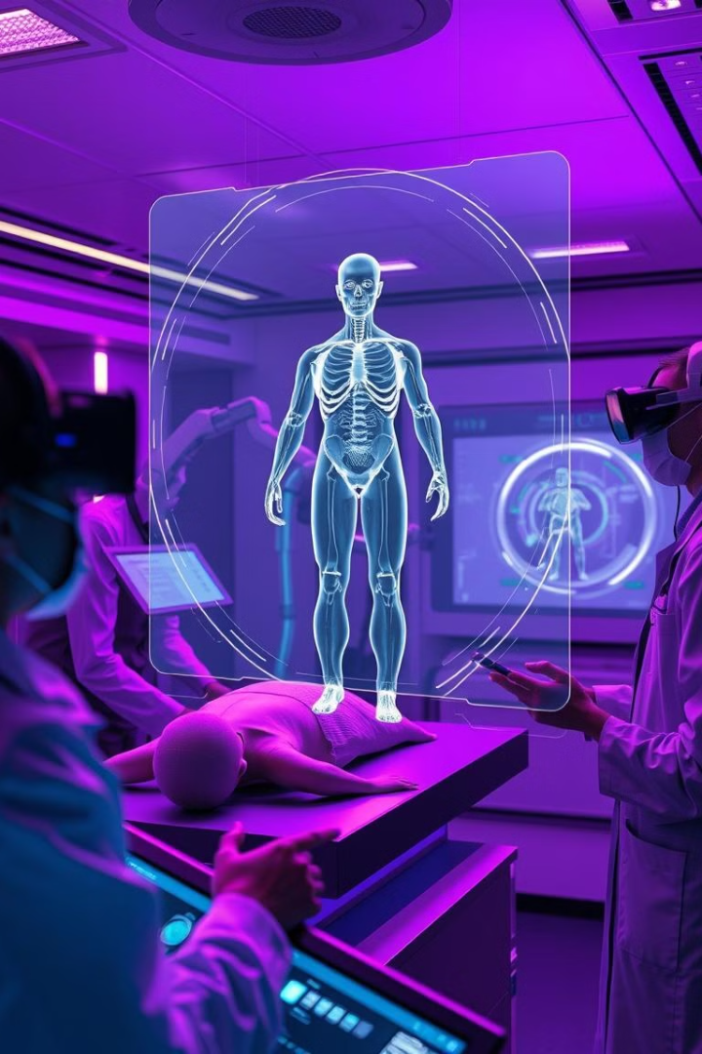
Future Developments and Integration Roadmap
Integration with wearable technology for continuous health monitoring
Development of advanced AI models for disease prediction and prevention
Integration with electronic health records (EHRs) for seamless data sharing

Slide 9




Real-world Example: A Chatbot for Diabetes Management
Blood Sugar Tracking
1
Reminds patients to check their blood sugar levels and logs readings
Medication Reminders
2
Provides timely medication reminders to ensure adherence
Personalized Diet Recommendations
3
Offers dietary guidance based on individual needs and preferences
Health Education
4
Provides valuable information on diabetes management and healthy living

Slide 10

Conclusion: Shaping the Future of Healthcare
AI healthcare chatbots hold immense potential to revolutionize patient care, providing accessible, convenient, and personalized healthcare experiences. With continued advancements in AI and integration with other technologies, these intelligent tools are poised to shape the future of healthcare, empowering patients and enhancing overall well-being.

